Slide 1
INTESTINAL OBSTRUCTION

Slide 2
HISTORY
3rd or 4th century-Praxagoras created an enterocutaneous fistula to relieve a bowel obstruction
Non-operative management with attempted reduction of hernias, laxatives, ingestion of heavy metals (e.g., lead or mercury), and leeches to remove toxic agents from the blood
Late 1800s-antisepsis and aseptic surgical techniques made operative intervention safer and more acceptable

Slide 3

Definitions
Dynamic Obstruction
  A mechanical blockage arising from a structural abnormality that presents a physical barrier to the progression of gut contents .
Adynamic(ileus)
  paralytic or functional variety of obstruction

Slide 4
Causes of intestinal obstruction
Mechanical (dynamic)
  Extrinsic
  Intramural
  intraluminal
Non mechanical(adynamic)
  Post-laparotomy
  Metabolic and electrolyte derangements (e.g., hypokalemia, hyponatremia, hypomagnesemia, uremia, diabetic coma)
  Drugs (e.g., opiates, psychotropic agents, anticholinergic agents)
  Intra-abdominal inflammation
  Retroperitoneal hemorrhage or inflammation
  Intestinal ischemia
  Systemic sepsis

Slide 5
Causes of intestinal obstruction
(international)
Adhesive disease (60 percent)
Neoplasm (20 percent)
Herniation (10 percent)
Inflammatory bowel disease (5 percent)
Intussusception (< 5 percent)
Volvulus (< 5 percent)
Other (< 5 percent)

Slide 6
Causes of intestinal obstruction (local situation)
sigmoid volvulus
external herniae
adhesions and bands
ileocolic intussusception
small bowel volvulus
VM Muyembe et al intestinal obstruction at a provincial hospital:East Afr Med J 2000 Aug;77(8): 440-3

Slide 7
Types of intestinal obstruction
Partial or complete
Simple or strangulated
Acute or chronic

Slide 8
Pathophysiology in mechanical obstruction
Increased peristalsis in the early stages
Bacterial proliferation
Distension with fluid and gas

Slide 9
Peristalsis
Increase in the initial stages
    Both proximal and distal to the obstruction
    Responsible for the initial diarrhea
    Perforation may occur
Later stages ileus

Slide 10
Bacterial proliferation
Organisms reaching concentrations of 10⁹ to 10¹⁰/mL
Responsible for the feculent vomitus
Translocation of bacteria and it’s toxins causing bacteraemia and septicaemia

Slide 11
Normal fluid secretion
salivary glands 1500
Stomach 2500
Bile 1500
pancreatic 1500
intestinal 1000

Slide 12
Distension with fluid and gas
The gas that accumulates in distended bowel comes from
Swallowed gas ( O₂ & N₂)
Product of bacterial fermentation (H₂, Methane & CO₂)
Gas exchange with the blood
Accumulated fluid
Swallowed fluid
Saliva
GIT secretions
Leakage of interstitial fluid into the bowel

Slide 13
Sources of fluid loss
The bowel lumen
Edematous bowel wall
Free peritoneal fluid
Vomiting

Slide 14
Clinical features
colicky abdominal pain
Nausea
vomiting
abdominal distention
failure to pass flatus and feces (i.e., obstipation).
tachycardia and hypotension
distended abdomen
visible peristaltic waves
hyperactive bowel sounds(borborygmi)
Localized or generalized abdominal tenderness
Presence of a hernia

Slide 15
Common Symptoms
symptoms No. Of patients % age
Pain 50 100
Vomiting 41 82
Abdominal distention 48 96
Absolute constipation 49 98
Adnan Ali Qureshi, Jahangir Sarwar Khan ;Intestinal Obstruction Changing Etiological Trends :j ournal of Rawalpindi Medical College (JRMC); 2008;12(2):78-81 78

Slide 16
Diagnosis
From history and physical examination
Investigations
  Radiological
    abdominal X-ray-sensitivity of 75%, and specificity of 53%
    Contrast studies
    Abdominal ultra sound
    Abdominal CT Scan -sensitivity of 93%, a specificity of 100%
    MRI
  Laboratory
    Hematocrit
    Hemogram
    Urea/electrolyte+creatinine

Slide 17
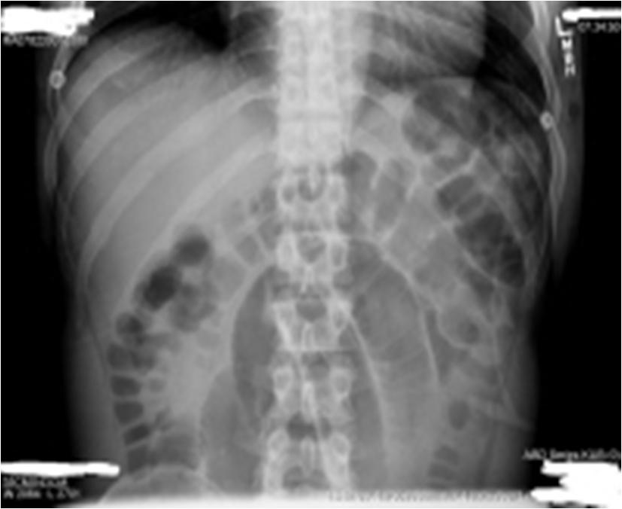
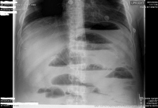
Plain x-rays

Slide 18
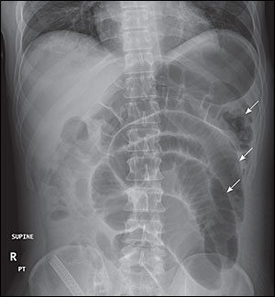
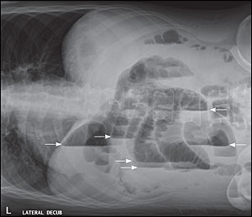
Plain X-rays

Slide 19
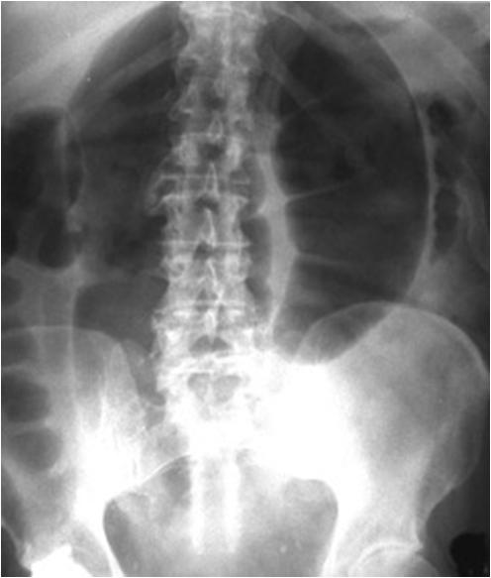
Plain x-ray: Sigmoid volvulus

Slide 20
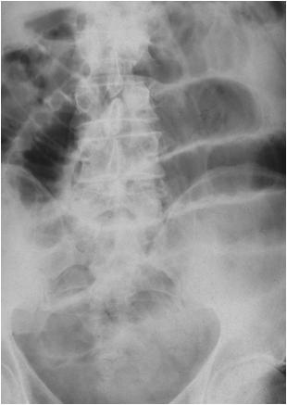
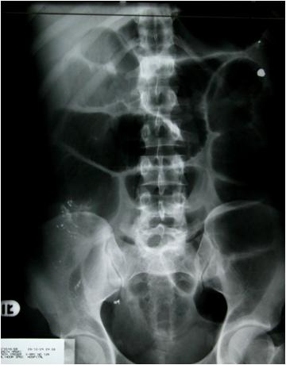
The Difference between small and large bowel obstruction

Slide 21
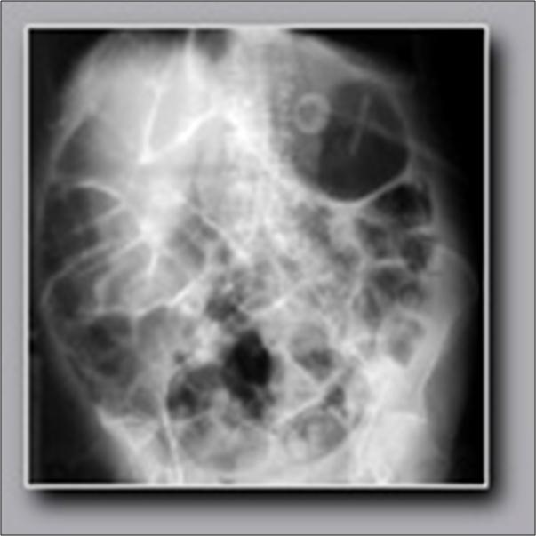
X-ray: Ileus

Slide 22
Treatment
Intravenous fluid resuscitation
Antibiotics(gram-negative and anaerobic organisms)
Urethral catheterization
K⁺ supplementation( may be necessary)
Nasogastric tube decompression
Analgesics-morphine
Operative management

Slide 23
Complications
Sepsis
Intra-abdominal abscess
Wound dehiscence
Aspiration
Short-bowel syndrome (as a result of multiple surgeries)
Death (secondary to delayed treatment)

Slide 24
Prognosis
If untreated, strangulated obstructions cause death in 100% of patients.
If surgery is performed within 36 hours, the mortality rate decreases to 8%.
The mortality rate is 25% if the surgery is postponed beyond 36 hours in these patients.
factors associated with death and postoperative complications include age, comorbidity, and treatment delay

